Slide 1
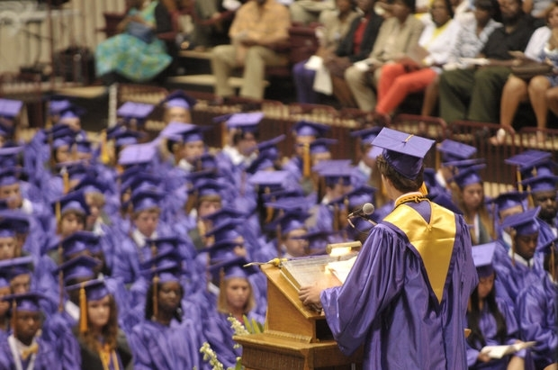
Dual Credit Opportunities

Slide 2
Objectives:
Philosophy and structure of each program
Scheduling for one or more programs
Assessments associated with each program
Success and advantages of each program
Costs associated with each program

Slide 3
Philosophy of Dual Credit Courses
To provide opportunities for qualified high school juniors and seniors to complete college-level courses while still enrolled in high school.
To provide opportunities for students to earn dual credit (high school and college credit) when courses include both college and high school requirements.
Notes:
For example, taking psy 101 gives them a weighted elective credit in high school while allowing them to earn 3 hours of college credit.

Slide 4
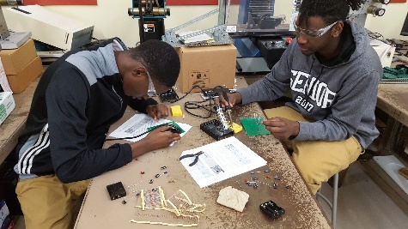
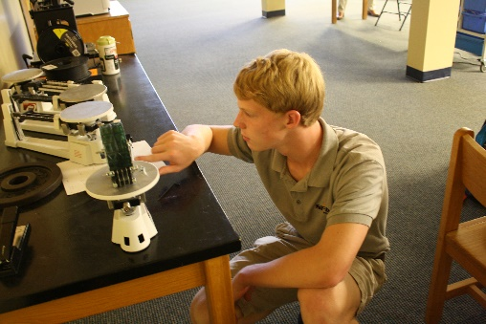
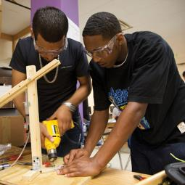
Project Lead The Way
I Introduction to Engineering Design
Principles of Engineering
Civil Engineering and Architecture
Digital Electronics
Notes:
`PLTW’s mission: Prepare students for the global economy
We help students develop the problem-solving, critical thinking, and collaboration skills needed to succeed in the global economy as they pursue college and career.
PLTW’s activity-, project-, and problem-based curriculum gives students a chance to apply what they know, identify problems, find unique solutions, and lead their own learning.
PLTW also delivers engaging, rigorous professional development for teachers to prepare them to engage students in the STEM subjects.
PLTW partners with leading corporations, philanthropic organizations, and educational institutions to create opportunities for our students in college and career.
Why is PLTW Important?
According to the U.S. Bureau of Labor and Statistics, nationwide employment in STEM jobs is expected to grow to more than 9 million by 2022. An estimated 1.2 million jobs in science, technology, engineering and math will be unfilled by 2018. PLTW addresses the education and workforce development challenges facing our nation by delivering high-quality, interdisciplinary STEM education programs to more than 6,500 schools across the country.

Slide 5
Dual Credit Opportunities
PLTW –Rochester Institute of Technology
Teacher Cadets—Winthrop University
English 101—USC-L
English 102—USC-L
Psychology 101—USC-L

Slide 6
Benefits of Dual Credit Courses
Dual Credit Courses are not dependent upon a score from a national exam.
Dual Credit Courses will be part of your college transcript when you enter college.
Dual Credit Courses in core areas are transferable to all in-state public colleges, some out-of-state public colleges, and a few private colleges.
Check with the college you are interested in attending to see how courses transfer.

Slide 7
Requirements for Dual Credit
USC-L classes
3.0 cumulative GPA
Teacher Cadet 101, WU
Overall 3.0 GPA or higher, teacher recommendation, and application

Slide 8
Cost Analysis What do you pay?*
USC-Lancaster (each course)
$285.00 for 3-hour course or no cost if
student takes 6 hrs/sem
Cost of textbooks
Winthrop
$30.00
PLTW
$225.00
* COSTS ARE SUBJECT TO CHANGE.

Slide 9
How Much Can I Save?
Each course at Winthrop, USC-L, or USC costs college students $900.00+.
Course costs are subject to change.

Slide 10
Cost: When Do I Pay?
Students will register to be a college student before the course begins.
In May, students will meet in a computer lab to complete the application together.
PLTW Engineering courses with USC— money is due at the end of the course.

Slide 11
Q & A
We invite you to the stage to talk with teachers and students about the individual dual credit classes.

